Slide 1
Why Study Computer Science using Python?
CSC 161: The Art of Programming
Prof. Henry Kautz
9/2/2009

Slide 2
Why Computer Science?
Everything is bits and computation!
Biology – Protein folding
Music – Sound processing
Mechanical Engineering – Load bearing
Literature – Text analysis
What are you studying?

Slide 3
Why Programming?
Simply using off the shelf applications will get you a long way
Spreadsheets
Photo editors
But if you are doing novel, creative work, sooner or later, you will need to solve a new problem
Learning good principles of programming will make it possible with more fun and less frustration
Analogy: Knowing how to cook versus microwaving TV dinners

Slide 4
Why Python?
Python is rapidly becoming a language of choice for
Scientists
Web site builders
Researchers in the humanities
All kinds of rapid prototyping
The old CSC 170 used JavaScript
Good for web page design
CSC 161 will give you a practical tool for your whole career

Slide 5
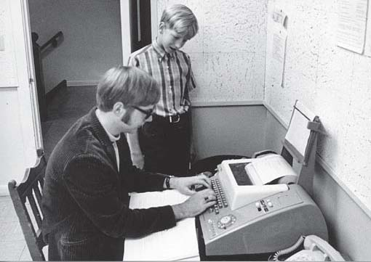
Why Love Python?
Named after Monty Python’s Flying Circus
Combines features of the most advanced programming languages …
Objects
First-class functions
Garbage collection
Polymorphic lists
With the simplicity of BASIC
BASIC programmers, circa 1969

Slide 6
Class Organization
Workshops
Preference sheets
Workshop placements given out next week
Workshops start Sunday Sept 13
Everything will be posted on the course web site
Labs start tomorrow, Sept 3
First assignment will be handed out later this class

Slide 7
Work & Grades
Meetings:
Lectures
Labs (hands on use of computers)
Workshops (group problem solving)
Your final grade will be based on
Weekly quizzes
Midterm & final exams
Weekly exercises
Final programming project
Grades are not curved
Let’s aim at 100% A’s!

Slide 8
Textbooks
Python Programming: An Introduction to Computer Science, by John Zelle
See Syllabus for links to a free online supplementary textbook and other online resources

Slide 9
Policies
Assignments will specify whether they are to be turned in at class or using Blackboard file upload
20% penalty for assignments 1 to 7 days late
No credit for assignments more than 7 days late
Students are encouraged to discuss course material with each other on the Blackboard discussion board
Academic honesty: all incidents will be reported to the College Board on Academic Honesty for investigation
We love visitors at office hours!
We are happy to provide classroom or testing accommodations!

Slide 10
History of Computing
What is a computer?
Something that performs an algorithm
What is an algorithm?
An unambiguous recipe for manipulating symbols
Symbols: numbers, characters, bits, …
Symbols may represent quantities, words, images, …
Key idea:
The computer does not need to know what the symbols mean
Computing requires accuracy, but not understanding

Slide 11
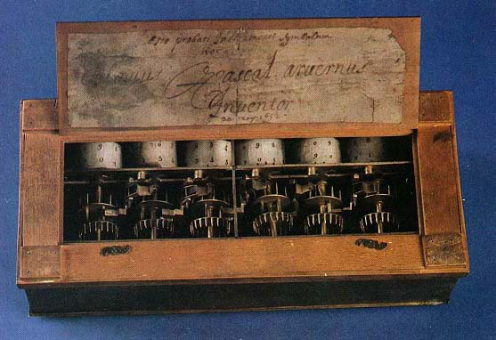
Early Computers
1642: Blaise Pascal invents the Pascaline
First adding machine
Use by Pascal’s father, a tax collector
Blaise is also famous for “Pascal’s wager”

Slide 12
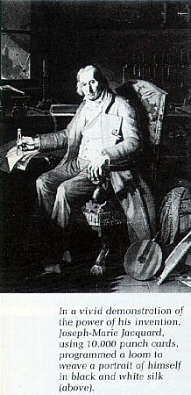
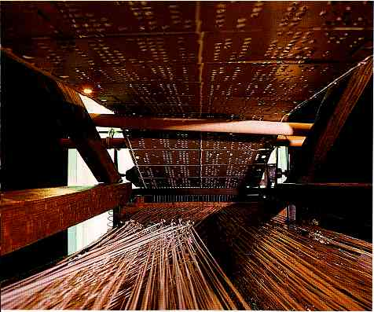
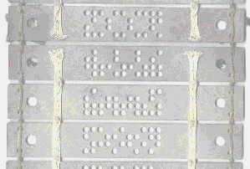
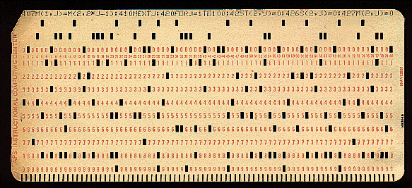
First Programmable Computer
1801: Jacquard’s Loom
Punch card programming
Punch card, circa 1970:

Slide 13
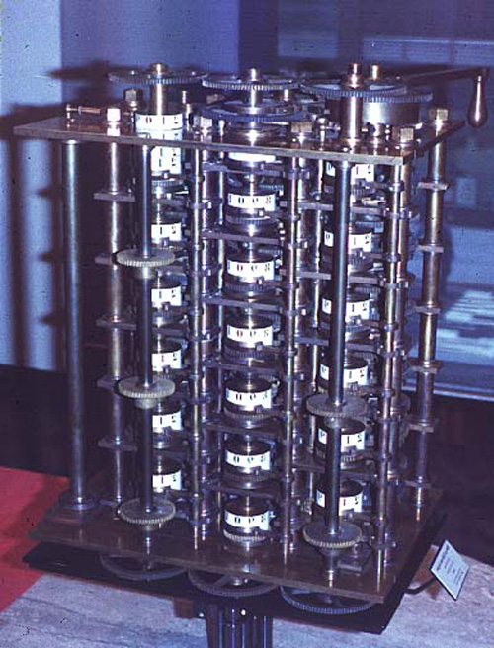
First General-Purpose Computer
1822: Charles Babbage’s Analytic Engine
Never completely built
In theory, could compute any mathematical function for which there is an algorithm

Slide 14
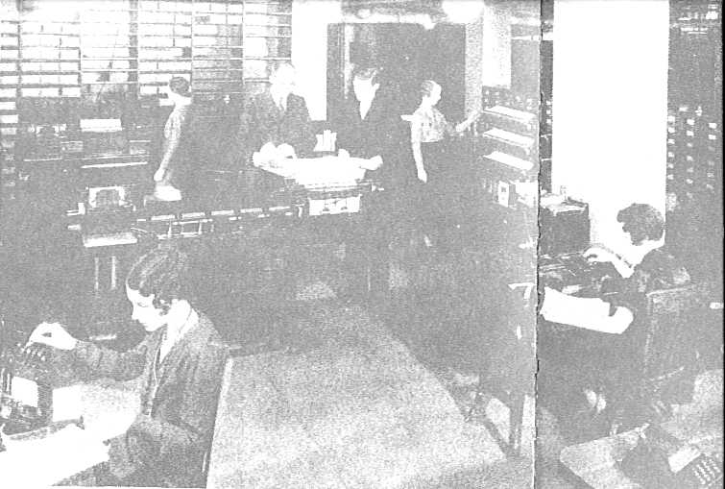
First Commercial General Purpose Computers
IBM Counting Table, circa 1910

Slide 15
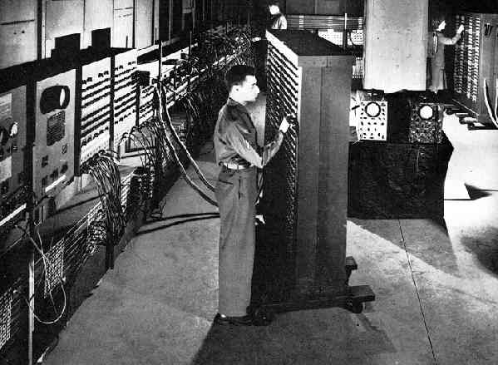
First Electronic Computer
1945: ENIAC, University of Pennsylvania
30 tons, 18,000 vacuum tubes

Slide 16
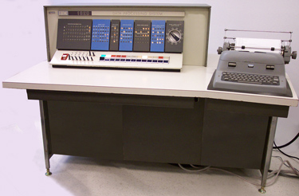
First Transistorized Computer
1964: IBM 1620
How I learned to program!

Slide 17
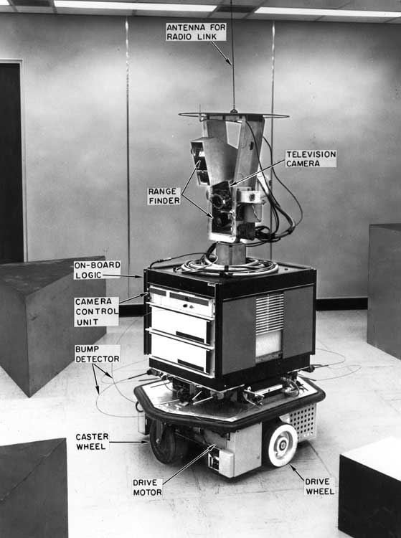
First Autonomous Computerized Robot
1970: Shakey, Stanford Research Institute

Slide 18
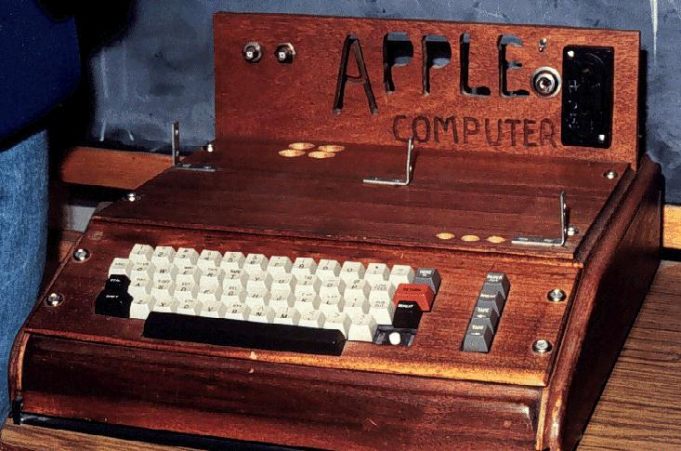
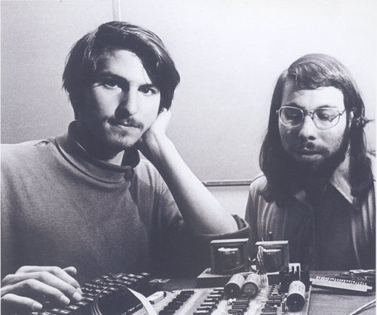
First Personal Computer
1976: Apple I

Slide 19
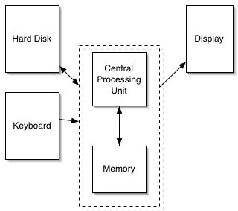
Modern Computer Architecture
The part that crunches symbols is the Central Processing Unit (CPU).
Memory (RAM)
Each byte (8 bits) has an address
Can store data
Can store instructions
Hard disk
“Secondary storage”
1000 times cheaper
1,000,000 times slower
Display (I/O)
LCD, printer, …
Often implemented as a special area of memory
Video RAM

Slide 20
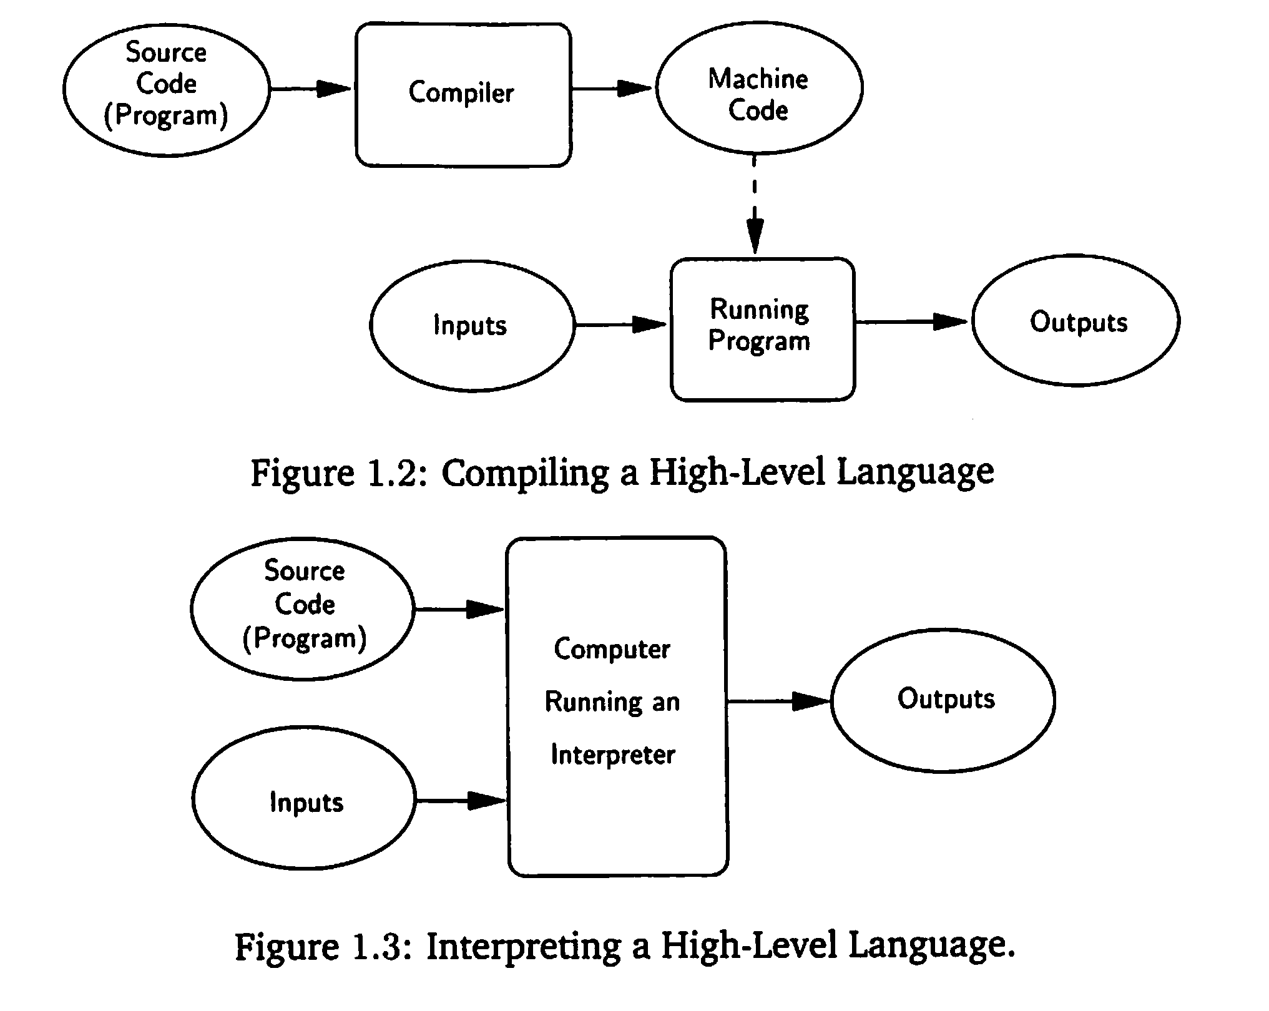
Computer Languages: Compiling versus Interpreting

Slide 21
Is Everything Computable?
Can a Python program be written for every well defined function?
Surprisingly: No!
Proof:
Imagine an alphabetical list of ALL Python programs that read a number as input
Consider the following function:
If the K-th program writes “Hello World” when given K as input, write “Goodbye World”
Otherwise, when given K as input, write “Hello World”
This function is logically impossible to write in Python!

Slide 22
Is there a Better Programming Language?
Is this limitation of Python?
No!
Church-Turing Thesis: all “suitably rich” programming languages can compute the same functions
Okay, enough philosophy…

Slide 23
Assignment #1
Read the first chapter of the textbook
Look at the online links on the Syllabus page to Getting Started with Python using IDLE
In your Lab section this week or next, carry out the assignment
Turn in the assignment sheet next class

