Slide 1
Graphics
CSC 161: The Art of Programming
Prof. Henry Kautz
10/12/2009

Slide 2
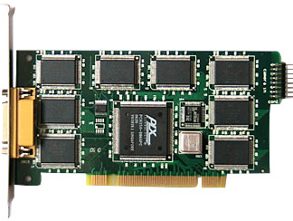
How Does a Computer Display Images?
Video RAM: area of memory dedicated to video output
Each word of video RAM corresponds to 1 pixel of the display
Example: For a 1024 x 768 pixel display, the pixel at coordinates (200,300) corresponds to video RAM address 200 + 300*1024
Value in the word corresponds to colors
Video RAM word: 3 bytes for Red, Blue, & Green
Each holds an integer 0 to 255
Red=255, Green=0, Blue=0 gives RED
Red=255, Green=128, Blue=64 gives BROWN
Program directs the CPU to write values to video RAM, video card processor reads video RAM and sends signals to CRT or LCD

Slide 3
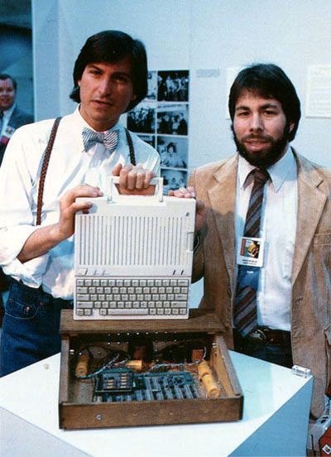
How Do We Program Graphics?
Old days: your program has to explicitly write to each pixel (video RAM address)
You want to display shapes, lines, or pictures of objects?
Program them yourself!
You want a shape to move across the screen?
Draw it
Erase it
Draw it somewhere else

Slide 4
How Do We Program Graphics?
Today: program libraries do most of the low-level work for us
Libraries include methods to
create
display
move
graphical objects such as
lines
shapes
images
Key idea: display = set of objects, each of which knows how to draw itself
Contrast: display = set of pixels, each of which must be set explicitly

Slide 5
Example: Graphics.py

Slide 6
Example: Graphics.py
from graphics import *
Use Zelle's graphics.py library
"from" notation – no need to prefix everything with "graphics."
Built on top of many other lower-level graphics libraries

Slide 7
Example: Graphics.py
win = GraphWin("frosty")
Create a window object with the string "frosty" on the title bar
Store that window object in the variable win

Slide 8
Example: Graphics.py
center = Point(100, 180)
Create a Point object with the given coordinates
Coordinate (0,0) is the top left corner (not bottom left!)
Y coordinate is positive going down (not negative!)
Store the point object in the variable "center"

Slide 9
Example: Graphics.py
circ = Circle(center, 40)
Create a Circle object centered at center with radius 40
Store the object in the variable "circ"

Slide 10
Example: Graphics.py
circ.setFill("white")
Tell the circle stored in circ to set is fill (interior) color to white

Slide 11
Example: Graphics.py
circ.draw(win)
Tell the circle (stored in) circ that it will draw itself in the window (stored in) win
The circle appears on the screen for the first time!
If it ever needs to redraw itself, it will do so automatically in the window win

Slide 12
Example: Graphics.py
w = win.getMouse()
Wait until the user clicks the mouse in window win
Put a Point object where the user clicked into variable w

Slide 13
Example: Graphics.py
win.close()
Tell the window win to disappear

Slide 14
Graphical Objects
Our introduction to object-oriented programming
Objects combine data with methods for computing with that data
Classes define kinds of objects
What kind of data they contain
What kinds of methods they understand
We can create many instances of the same class

Slide 15
Creating Objects
Constructors create instances of a class
<class-name>( <param1>, <param2>, ... )
p = Point(50, 60)
circ = Circle(p, 40)
win = GraphWin('Frosty')

Slide 16
Performing Operations on Objects
The operations an object knows how to perform are its methods
You tell an object to perform a method by sending a message of the form:
<object>.<method-name>(<param1>, <param2>,... )
circ.setFill('white')
circ.draw(win)
win.getMouse()
win.close()

Slide 17
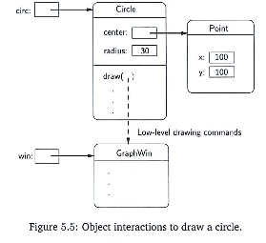
Object Interactions

Slide 18
Interactive Graphics
The computer mouse was invented in by Douglas Englebart in 1968 as a tool for interacting with computer graphics
p = win.getMouse()
Let's write a simple interactive graphical program

Slide 19
Coming Up
Don't miss workshop this week!
Crucial material for graphics
Quiz returned
Rules for correcting your quiz and having it re-graded
New programming assignment coming out Tuesday
Will be done with new partners assigned by lab TA's

