Slide 1
The Future of Computing
CSC 161: The Art of Programming
Prof. Henry Kautz
12/2/2009

Slide 2
Helping Design CS 161
This is the first time CS 161 has been offered
I would like your help in designing the course for the next time it is taught
Please take 15 minutes to fill out this survey
It is not the course evaluation, you still should complete the online evaluation
Instead: we want to know what material in the course we should keep or replace

Slide 3
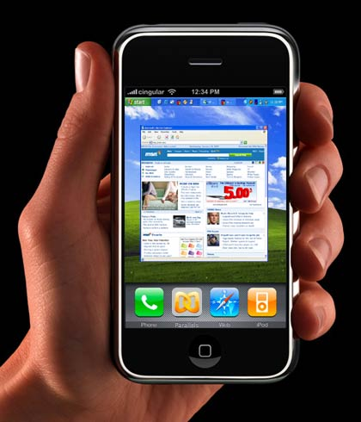
Future of Computing
The future of computing is likely to be different than anything we expect
(Almost) no one predicted
  Personal computers
  Cell phones
  Electronic mail
  Video games
  The world wide web
  Cell phones with cameras
  Online shopping
  Text messaging
  iPods
  YouTube
  Social networking (FaceBook)
  Smart phones

Slide 4
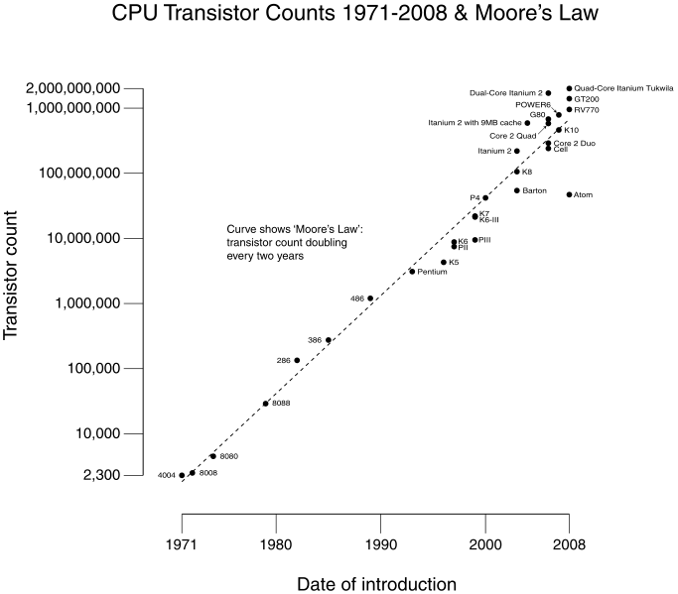
Moore's Law

Slide 5
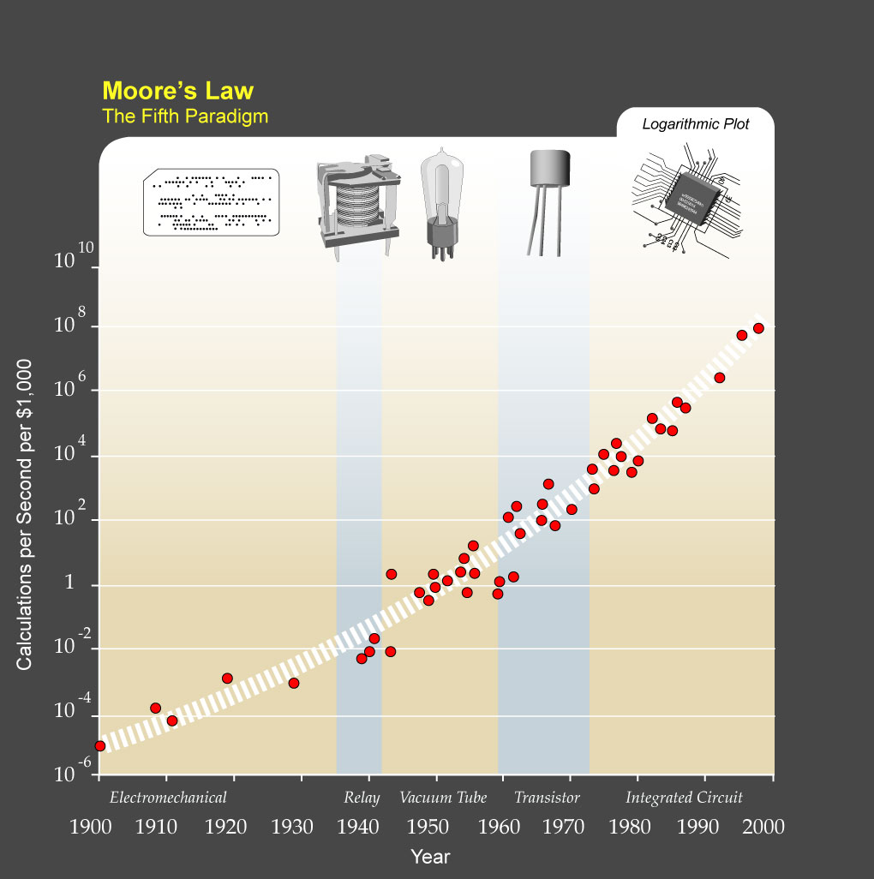

Slide 6
The Million-Dollar Radish
In 1999, my department at AT&T Bell Labs spent $1,000,000 on a computer from Silicon Graphics Incorporated
  8 GB of RAM
  8 processors
We named it "Daikon", after a kind of Japanese radish
You can buy an equivalent PC today for $1,000

Slide 8
It's Not About Speed
Although Moore's law helped spark the revolution, the transformation of computing is no longer about speed
It's about computers becoming pervasive in every aspect of life
We may been reaching the speed limit for conventional computers
  Quantum computers might speed things up by a square-root factor (10^100 → 10^10)
  But that may not be very important, unless you are splitting atoms...

Slide 9
One Future Trend:
Computer Caregivers

Slide 10
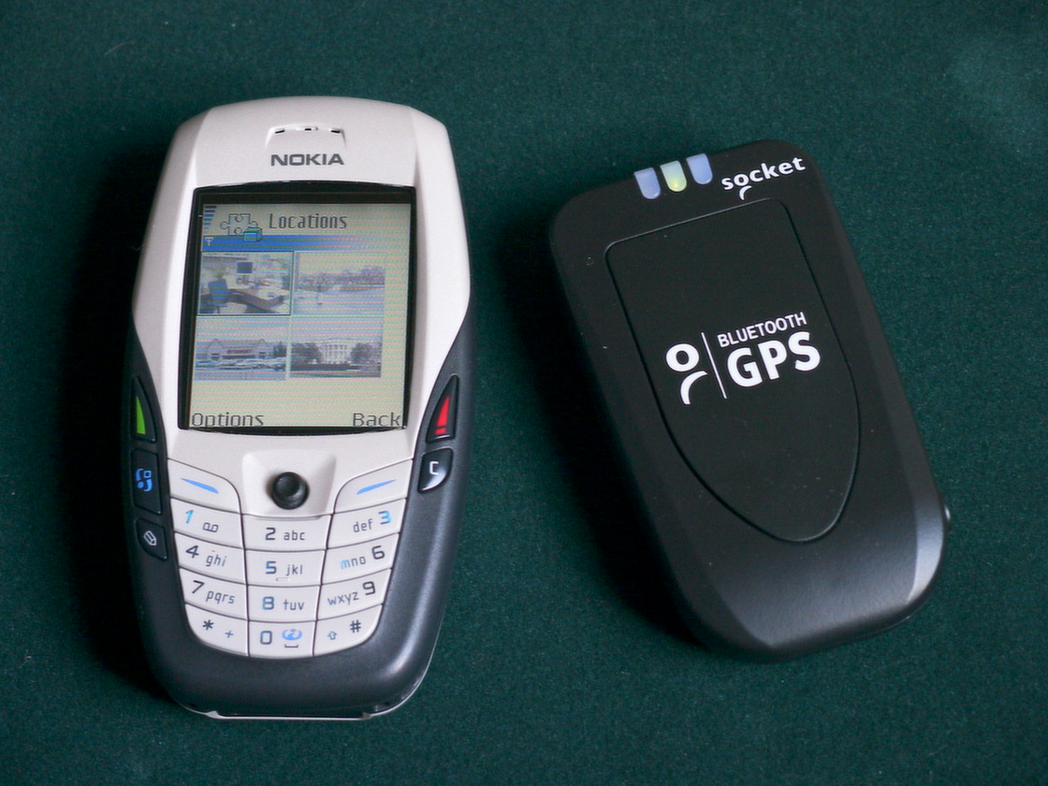
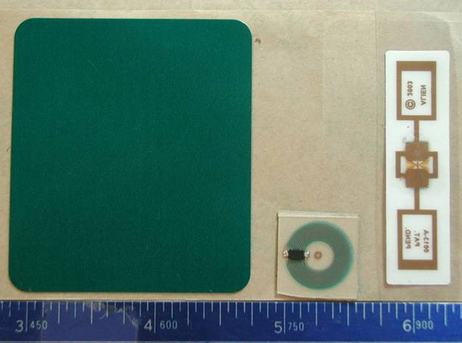
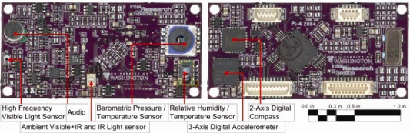
Growing Ubiquitous Sensing Infrastructure
GPS
Wi-Fi localization
RFID tags
Wearable sensors

Slide 11
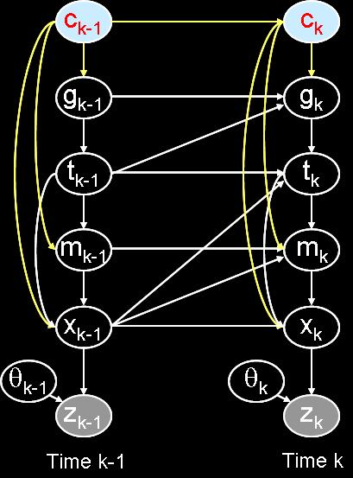
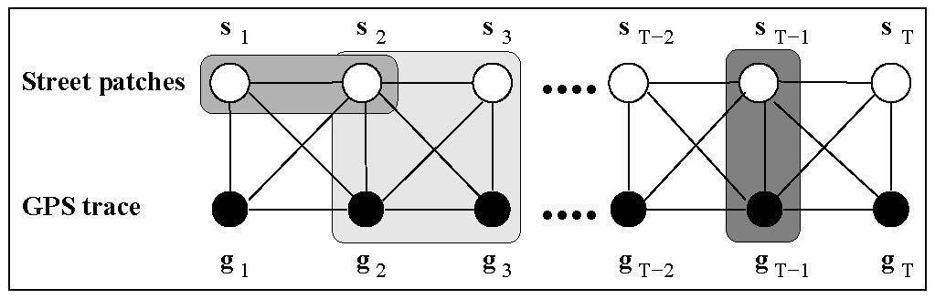
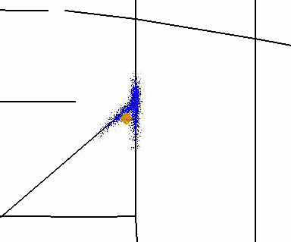
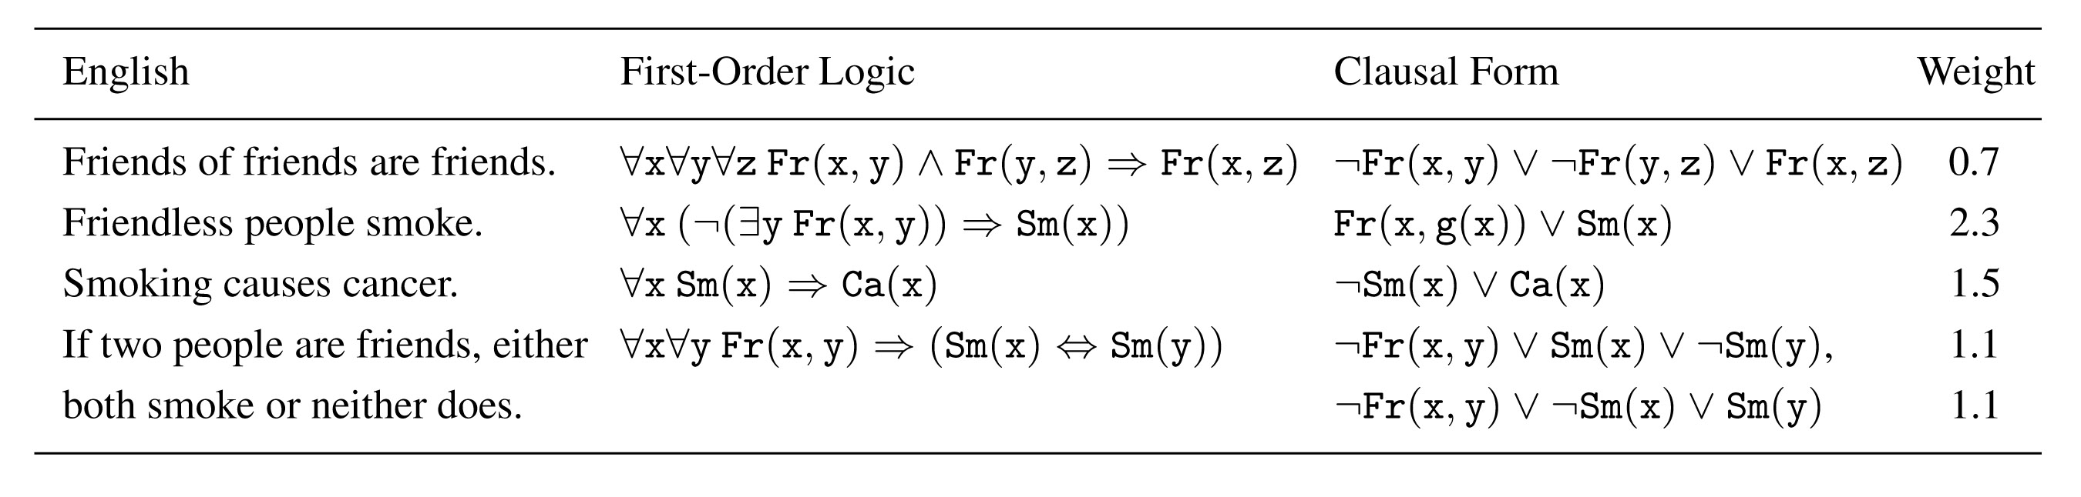
Advances in Artificial Intelligence
Graphical models
Particle filtering
Belief propagation
Statistical relational learning

Slide 12
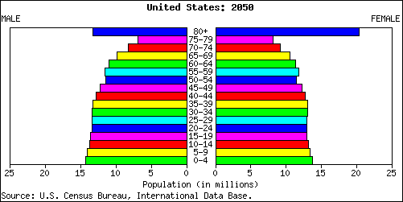

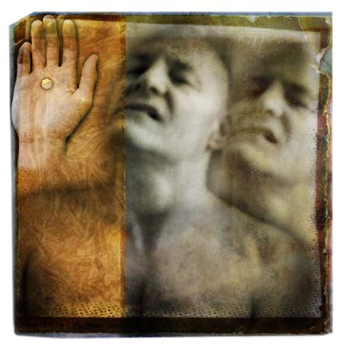
Crisis in Caring for the Cognitively Disabled
Epidemic of Alzheimer’s
Community integration of 7.5 million citizens with MR
100,000 @ year disabled by TBI
Post-traumatic stress syndrome
Caregiver burnout

Slide 13
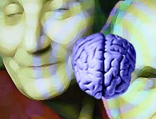
Pioneering an Emerging Area
Assisted Cognition
  Computer systems that enhance the abilities, independence, and safety of persons with cognitive disabilities
    Aging and age-related diseases
    Brain injury
    Developmental disabilities
  Computer caregivers

Slide 14
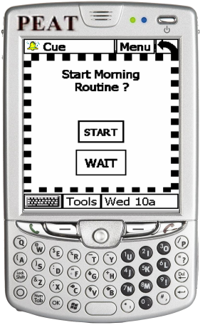
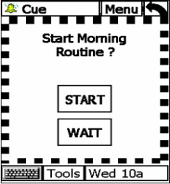
Examples
Maintaining a daily schedule
  Compensating for memory problems
  Compensating for lowered self-initiative
  Step-by-step task prompting
Navigation
  Indoors and outdoors
Safety and health
  Need for immediate help
  Long term health trends

Slide 15
General Architecture
common-
sense
knowledge
cognitive state
decision
making
intentions
user
profile
activities
physical behavior
user
interface
caregiver
alerts
machine
learning
sensors

Slide 16
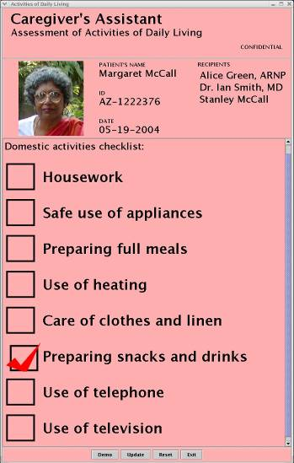
Activity of Daily Living Monitoring
Goal: Accurate, automated ADL logs
  Changes in routine often precursor to illness, accidents
  Human monitoring intrusive & inaccurate

Slide 17
Object-Based Activity Recognition
Activities of daily living involve the manipulation of many physical objects
  Kitchen: stove, pans, dishes, …
  Bathroom: toothbrush, shampoo, towel, …
  Bedroom: linen, dresser, clock, clothing, …
We can recognize activities from a time-sequence of object touches

Slide 18
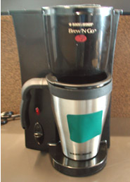
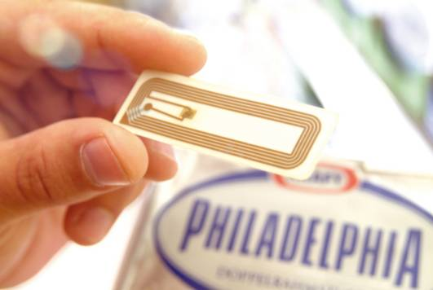
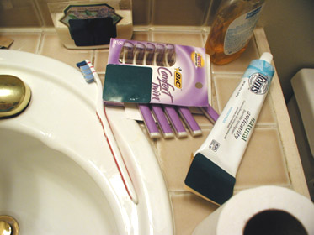
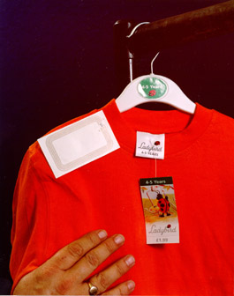
Sensing Object Manipulation
RFID: Radio-frequency identification tags
  Small
  Semi-passive
  Durable
  Cheap
Near future: use products’ own tags

Slide 19
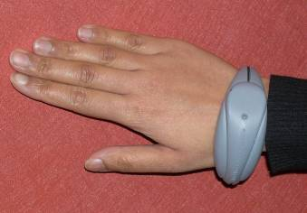
Wearable RFID Reader
Bracelet reads tags near hand, transmits information wirelessly to monitoring system
Soon will be built into a wristwatch

Slide 20
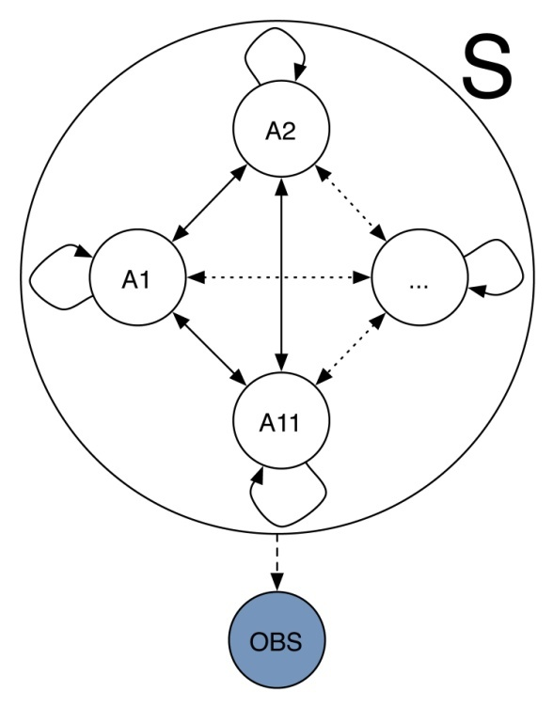
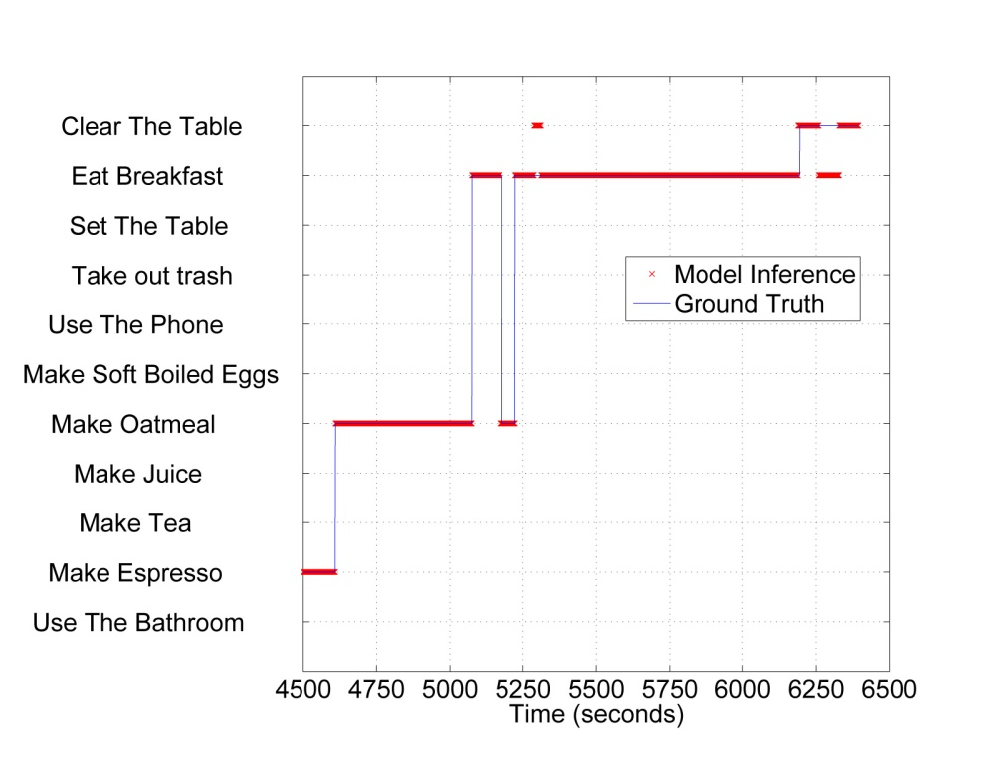
Interpreting the Sensor Data: Machine Learning
Machine learning algorithms automatically create the recognition system from training examples
Can handle sensor noise and user errors

Slide 21
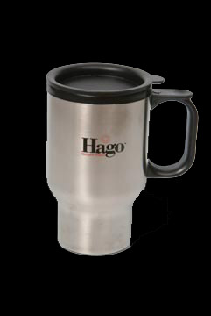
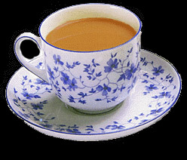
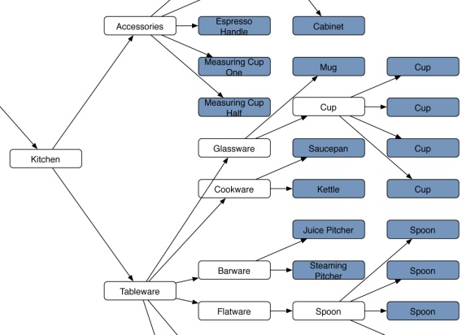
Using Commonsense Knowledge
Can further improve the system by adding “commonsense knowledge”
Example: a travel mug is like a cup

Slide 22
Results: Detecting ADLs
Activity | Prior Work | SHARP
Personal Appearance |  | 92/92
Oral Hygiene |  | 70/78
Toileting |  | 73/73
Washing up |  | 100/33
Appliance Use |  | 100/75
Use of Heating |  | 84/78
Care of clothes and linen |  | 100/73
Making a snack |  | 100/78
Making a drink |  | 75/60
Use of phone |  | 64/64
Leisure Activity |  | 100/79
Infant Care |  | 100/58
Medication Taking |  | 100/93
Housework |  | 100/82
Legend
RFID
General solution
Point solution
Inferring ADLs from Interactions with Objects
Philipose, Fishkin, Perkowitz, Patterson, Hähnel, Fox, and Kautz
IEEE Pervasive Computing, 4(3), 2004

Slide 23
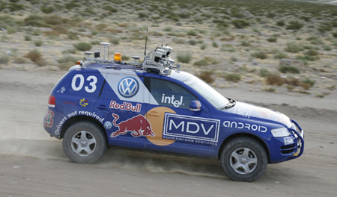
Other Futures
Self-Driving Cars
  DARPA Grand Challenges, 2004-2007
  Races in desert and urban environments by fully autonomous vehicles
  Succeeded with “off the shelf” AI technology!

Slide 24
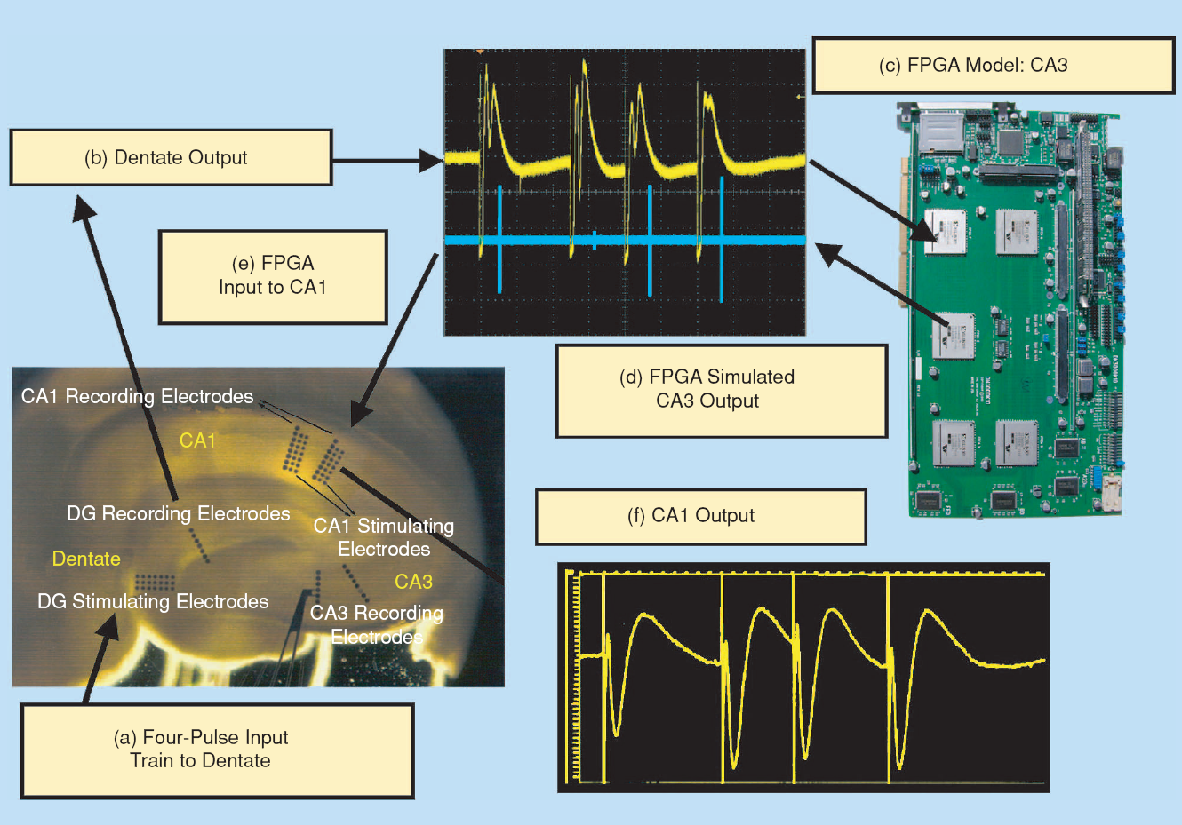
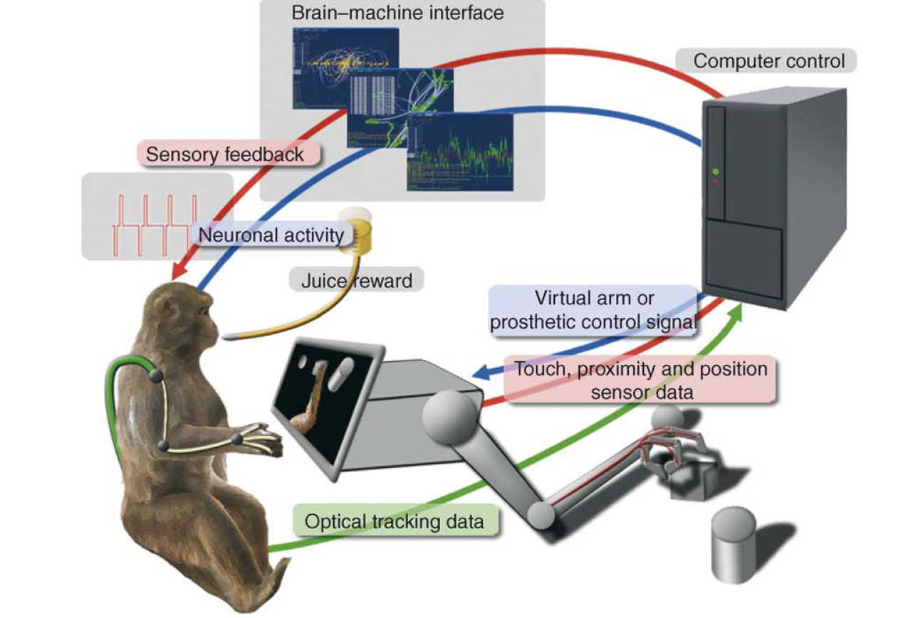
Other Futures
Brain-Machine Interfaces
  Cure paralysis
  Replace damaged portions of the brain

Slide 25
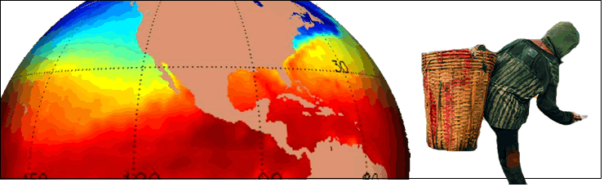
Other Futures
Computational Sustainability
  Sensors + Computation to sense, understand, simulate, and manage ecosystems
  Save the world using our natural resources more wisely

Slide 26
Your (Immediate) Future
162 The Art of Data Structures
  How to think like a computer scientist
  Writing efficient and reliable algorithms
132 Recreational Graphics
  Writing your own video games
190B Machines & Consciousness
  Philosophy, logic, and artificial intelligence
210 Web Programming
  Writing web-based applications
290C Advanced Robotics
  Program real robots (in Python and other languages)

Slide 27
Your (Longer Term) Future
290H Human Computer Interaction
  Principles of design and testing for ease of use
  Creating ways of interacting with computers
242 Artificial Intelligence
  Core topics in automated reasoning
  Build your own AI software agent
252 Computer Organization
  The nitty gritty of operating systems

